Slide 1
Power BI Governance

Slide 2
How are reports secured an shared? AD groups and DLs|what about office 365 groups
What are your AD group policies
What is your System Usage,Montoring,Auditing Stratregies
What are your licensing policies
How are the PBIX files handled,where are they stored
What are your report embedding policies and practices
What is your report distribution strategy
What are your requirement around data freshness? Do this vary by Data source
Do you have Data gateways built at on -Prem
Do You need your Data to be restricted at Role-level

Slide 3
Why Power BI Governance
Security
Compliance
Data Restriction/Sharing
Auditing
Notes:
Lack of PowerBI Governance What Else Can happen
Security Breaches
Data Privacy and/Or Regulatory violations
Not able to properly manage licensing
Breach of Organizational Complaince

Slide 4
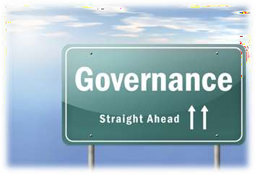

What is Governance? (In the IT context)
A formal framework that provides a structure for organizations to ensure that IT investments support business objectives.
ITIL – Information Technology Infrastructure Library is a Governance Framework
GRC – Governance Risk & Compliance is another Framework established in 2000 in US for large corporations
ISO 27001 – is the IT related framework

Slide 5
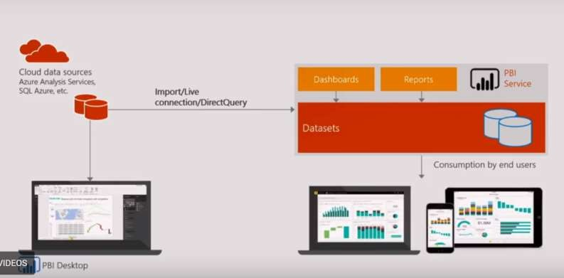
Where is Governance involved?
Direct Query?
Cash/import data?
Design
Data Integrity Scheduled connections
On Prem DB
Who can Edit?
How and who access Data Source?
Templates and custom visuals
to use
Who can consume?
Similar across devices? Special authentication?

Slide 6
Key Features of Power BI Governance
Active Directory Integrated Security
Capacity Planning
Organizational Content Packs
GDPR Compliance
Row-Level Security
0365 Groups
In Built - Auditing

Slide 7
Benefits to customer
High Security
Data Compliance
Automated Policy management
License Management from PBI Portal
Organizational Compliance
Capacity Management/Inbuilt audit

Slide 8
Power BI Delivery Approaches
Business-Led Self-Service BI | IT-Managed Self-Service BI | Corporate BI
Bottom-Up Approach | Blended Approach | Top-Down Approach
Analysis using any type of data source; emphasis on data exploration and freedom to innovate | A “managed” approach wherein reporting utilizes only predefined/governed data sources | Utilization of reports and dashboards published by IT for business users to consume
Ownership: Business supports all elements of the solution | Ownership: IT: data + semantic layer Business: reports | Ownership: IT supports all elements of the solution
Scope of Power BI use by business users: Data preparation, data modeling, report creation & execution | Scope of Power BI use by business users: Creation of reports and dashboards | Scope of Power BI use by business users: Execution of published reports
Governed by: Business | Governed by: IT: data + semantic layer Business: reports | Governed by: IT

Slide 9
Power BI Governance Model
Peoples and Practices
Processes
Technologies

Slide 10
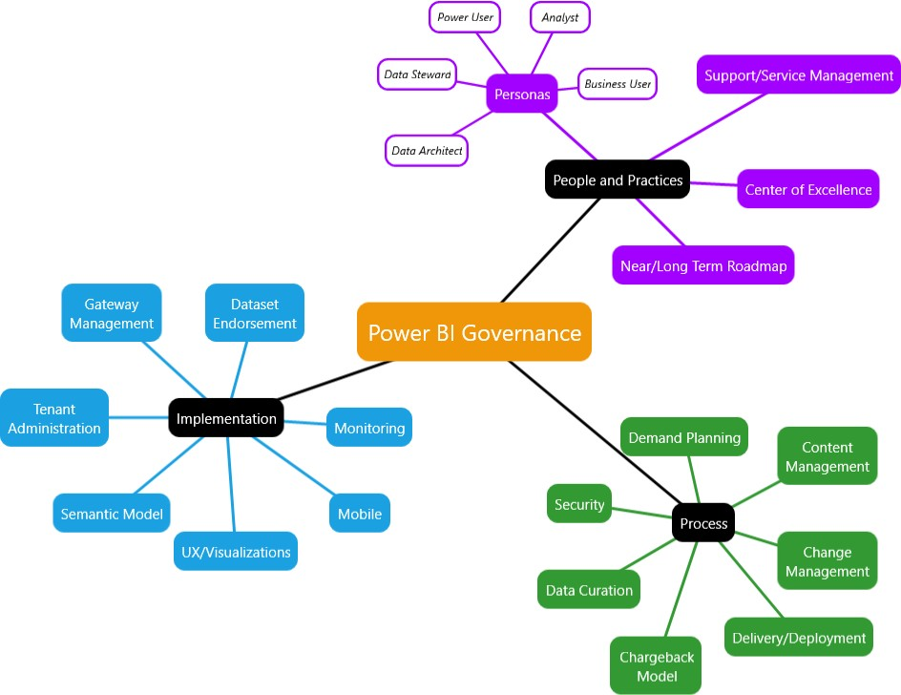

Slide 11
SNP Offers:
Features:
SNP will help you establishing with right licensing model as per your Organization size and needs
SNP helped Customers by setting up environment administration, Environment and report consistency
SNP helps customer by understanding there Compliance / Organization data policies , and building a perfect role assignments by enabling Azure AD security , AD Security avoids Security breach
SNP Helps customer by enabling required tenant settings ,Audit reporting ,Usage patterns in Power BI portal.
SNP helps customers by enabling Multi Cluster Hybrid gateways and governing the performance /security through pre-built Microsoft monitoring templates.
SNP Ensures High security standards by leveraging 0365,Azure AD , Power BI Roles based Data governance .
SNP helps Customer to be successful by understanding there Enterprise business needs and Suggesting them various Robust ,Cost effective ,Secured Solutions
Data Connectors: 80+ Data connectors Spanning broadly across On-premises ,Cloud, CRM, Marketing, API, Oracle, etc.
License Management: Power BI Is available in 3 different licensing approaches for your business needs
Data Preparation: In Built Data modelling ,Data Preparation ,Data Transformation Features. Avoids Depending Upon Third party Tools for Smaller Datasets.
Visualization: Rich Native visualizations, along with Custom visualization, helps your data understanding better with Stephen methodology.
Data Refresh: Data is refreshed live as per Business SLA.
ML & AI: Deeply Integrated and ML & AI ,Now Business can not only see metric, They can Analyze themselves and talk to data using AI
Security: Data is Restricted with RLS ,Active Directory Permissions, Privileges
Report Sharing: Automated report publish with scheduled emails in various formats like PDF,PBIX,PPT from a single user to Large group of audience

Slide 12
HYBRID BI SNP’S 2 WEEK Power BI Governance IMPLEMENTATION PROCESS
Input/Roles
Week 1
Week 2
Deliverables
From Customer
Power BI Service portal admin access or Service account which has admin access
Type of Security, Governance as Per Business /Customer needs
Discovery
Understanding there existing IT Landscape ,Security Standards, report sharing ,Visual governance ,Compliance policies
Understanding licensing needs ,capacity , Report Accessing policies, Data sources
Implementation
After Understanding of Inputs from discovery phase
Building workspace for and Report publishing ,and AD groups /0365 for report publishing
Assigning Read/Reshare/Reuse roles as per Business /user assignments of organization
Assigning Proper licenses as per size of business,
Enabling auto audit/Capacity sizing as per business needs
Endorsing Data sources as per the standards for reusability
Providing Documentation by Knowledge transfer for the client IT Teams
Measure system use and frequency, and track popular reports and dashboards. Deliver value to users and drive adoption by monitoring rendering speed and report performance
Continue security monitoring to help ensure compliance with regulatory requirements.
Review data source usage information to identify potential flaws in data integrity or even overlap in effort.

